Slide 1
Prioritizing Tasks for Maximum Productivity
Group : 3
Time Management

Slide 2

Why Time Management Matters
Time is a limited and valuable resource.
Poor management leads to stress, missed deadlines, and reduced performance.
Prioritizing tasks helps us focus on what truly drives results.
Quote: “Don’t be busy, be productive.”

Slide 3
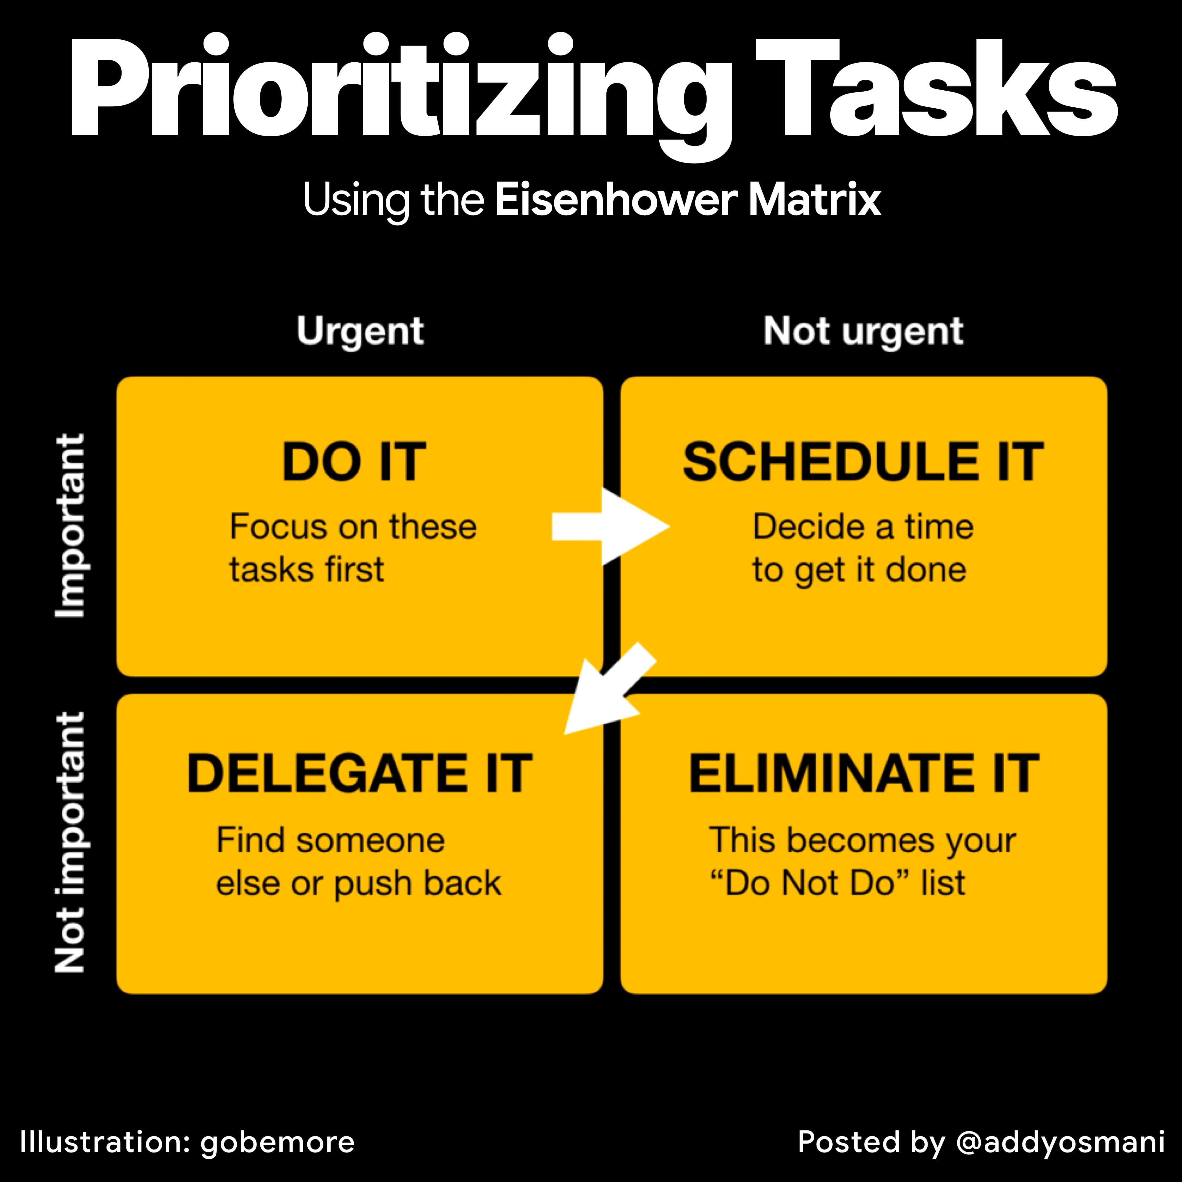
Understanding Task Prioritization
Task prioritization = deciding which tasks are most important.
Helps in:
• Avoiding chaos and last-minute stress
• Improving focus and clarity
• Meeting deadlines efficiently
Key Question: What task will have the greatest impact if I do it today?

Slide 4
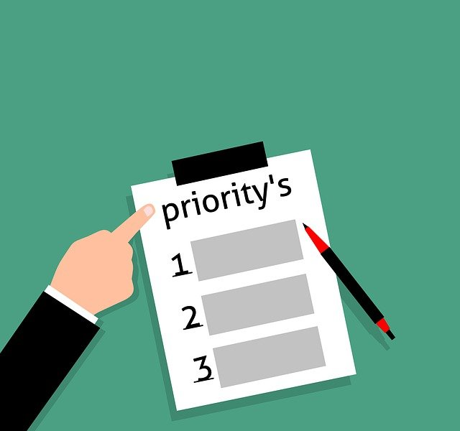
Common Challenges in Prioritizing Tasks
Procrastination – delaying important work
Lack of clarity – unclear goals or priorities
Distractions – phone, social media, multitasking
Overcommitment – saying 'yes's to everything
Tip: Start your day with a clear list of top 3 priorities.

Slide 5
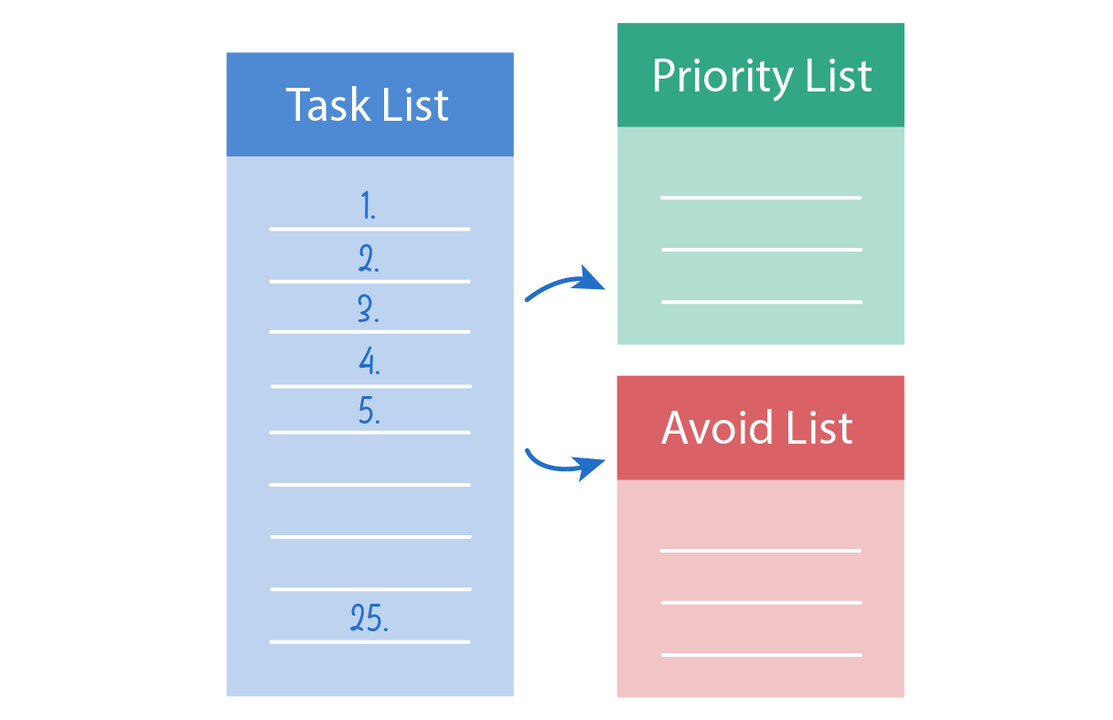
Tools & Techniques for Prioritization
Digital Tools: Todoist, Trello, Notion, Google Calendar.
Time Blocking: Schedule focused time for priority tasks.
Pomodoro Technique: Work in focused intervals (25 mins + short breaks).
Daily Review: Adjust priorities as tasks evolve.

Slide 6

Strategies for Maximum Productivity
Set SMART goals (Specific, Measurable, Achievable, Relevant, Time-bound)
Avoid multitasking – focus deeply on one task
Learn to say 'No' when necessary
Reflect and review priorities daily.

Slide 7

Conclusion & Key Takeaways
Prioritizing tasks = doing what matters most.
Results in:
• Higher productivity
• Lower stress
• Better balance and satisfaction
Final thought: “You can’t do everything, but you can do the right things well.”

